Slide 1


Introduction to
Robotic Process Automation
Sales Report Automation
220701260
SHANJAY KRISHNAA S
CSE-D

Slide 2
Abstract
The Sales Report Automation project uses UiPath to automate the generation and delivery of sales reports. It retrieves sales data from databases or CRMs, processes it, and formats it into a predefined Excel template. The system then composes and sends emails with the report attached, ensuring accuracy, efficiency, and timely delivery. With error-handling capabilities, it reduces manual effort and streamlines sales reporting processes.
Department of Computer Science and Engineering
Rajalakshmi Engineering College ‹#›
Notes:
‹#›

Slide 3
Need for the Proposed System
Accurate and timely sales reporting is crucial for effective decision-making. Manual processes for report generation and distribution are time-consuming, error-prone, and inefficient, often leading to delays and data inaccuracies.
The proposed automation system eliminates these challenges by streamlining the entire workflow, from data retrieval to report delivery. It ensures consistency through predefined templates, reduces human errors, and saves time. Automated email distribution guarantees that reports reach stakeholders promptly, enabling quicker and more informed decisions.
This system is essential for optimizing resources, minimizing delays, and enhancing the overall efficiency of sales reporting processes.
Department of Computer Science and Engineering
Rajalakshmi Engineering College ‹#›
Notes:
‹#›

Slide 4
Advantages of the Proposed System
Time Efficiency: Automates report generation and email delivery, drastically reducing the time required compared to manual processes.
Error Reduction: Ensures accuracy by minimizing human errors in data processing and reporting.
Timely Delivery: Guarantees prompt distribution of reports to stakeholders, enabling faster decision-making.
Consistency: Maintains uniformity across all reports with standardized templates.
Cost-Effectiveness: Lowers operational costs by reducing manual effort and optimizing resource utilization.
Scalability: Supports integration with various data sources and templates, making it adaptable to different business needs.
Department of Computer Science and Engineering
Rajalakshmi Engineering College ‹#›
Notes:
‹#›

Slide 5
Literature Survey
Paper 1: "Automating Business Reports Using RPA Tools"
Advantages:
Demonstrates how RPA tools streamline report generation, reducing manual effort and errors.
Highlights integration capabilities with various data sources like CRMs and databases.
Provides case studies showing significant time and cost savings in report workflows.
Disadvantages:
Limited scalability for handling complex reporting needs without additional customization.
Dependency on stable input data formats; changes in structure can disrupt automation.
Paper 2: "Improving Organizational Efficiency through Sales Report Automation"
Advantages:
Focuses on improving decision-making speed through automated and timely report delivery.
Discusses enhanced data accuracy and consistency achieved using predefined templates.
Explores the use of error-handling mechanisms to ensure reliability in the workflow.
Disadvantages:
High initial setup costs for configuring RPA systems.
Requires technical expertise for maintenance and updating automation workflow
Department of Computer Science and Engineering
Rajalakshmi Engineering College ‹#›
Notes:
‹#›

Slide 6
Main Objective
The primary objective of this project is to automate the process of generating and delivering sales reports using UiPath, an RPA tool. The system aims to streamline data retrieval, processing, and formatting into predefined templates, ensuring accuracy and consistency. Additionally, it automates email composition and delivery, enabling timely and efficient distribution of sales reports to stakeholders. By eliminating manual efforts, the project enhances productivity, reduces errors, and supports informed decision-making in sales operations.
Department of Computer Science and Engineering
Rajalakshmi Engineering College ‹#›
Notes:
‹#›

Slide 7
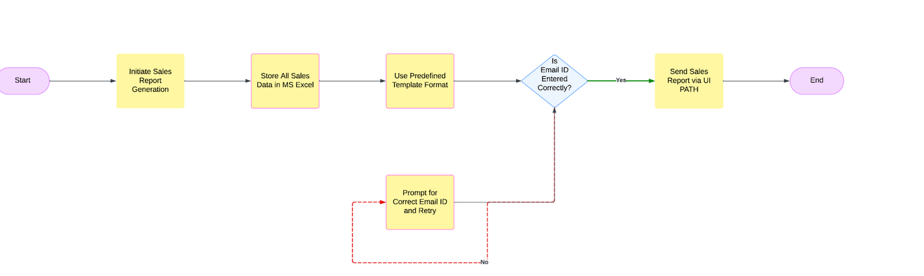
Architecture
Department of Computer Science and Engineering
Rajalakshmi Engineering College ‹#›
Notes:
‹#›

Slide 8
System Requirements
Hardware Requirements
Processor: Intel i5 or higher
RAM: 8 GB (16 GB recommended)
Storage: 256 GB SSD or 500 GB HDD
Network: Stable internet connection
Software Requirements
Operating System: Windows 10 or later
Automation Tool: UiPath Studio
Email Service: SMTP server or Outlook
Spreadsheet Software: Microsoft Excel (2016 or later)
.NET Framework: Version 4.7.2 or later
Department of Computer Science and Engineering
Rajalakshmi Engineering College ‹#›
Notes:
‹#›

Slide 9
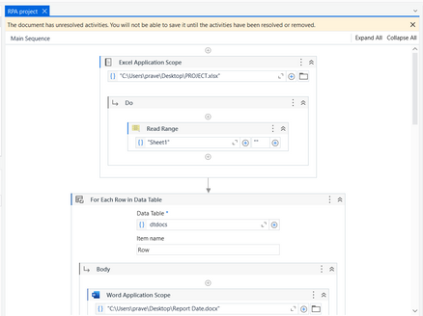
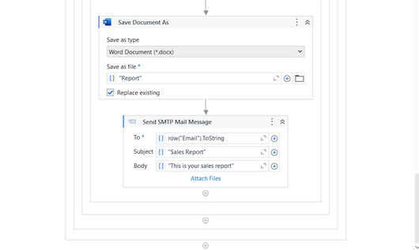
Functional Description
Module 1:Report Generation Module
This module automates the creation of personalized reports by reading data from an Excel file, iterating through each row, and replacing placeholders in a Word document with the corresponding data. It ensures efficient and accurate generation of customized reports.
Module 2:Save Document and Email Sending Module
Once all placeholders in the document are replaced, the Save Document As activity saves the updated Word file under a specified name, such as "Report". This ensures that the personalized report is ready for further use. Following this, the Send SMTP Mail Message module automates the emailing process. It retrieves the recipient’s email address from the dataset, attaches the saved report, and sends an email with a predefined subject ("Sales Report") and message body ("This is your sales report"). This module ensures seamless and automated delivery of the finalized sales report to the respective stakeholders.
These modules form the core of the automation, combining data processing, document generation, and email dispatching into a streamlined workflow.
Department of Computer Science and Engineering
Rajalakshmi Engineering College ‹#›
Notes:
‹#›

Slide 10
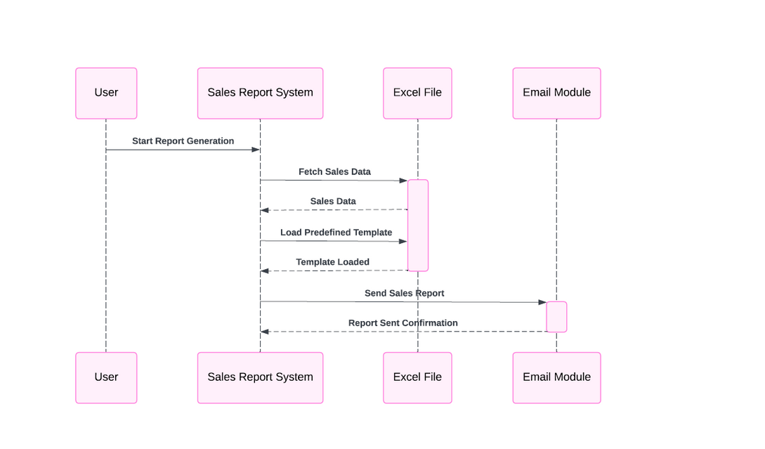
Table Design
Sequence Diagram
Department of Computer Science and Engineering
Rajalakshmi Engineering College ‹#›
Notes:
‹#›

Slide 11
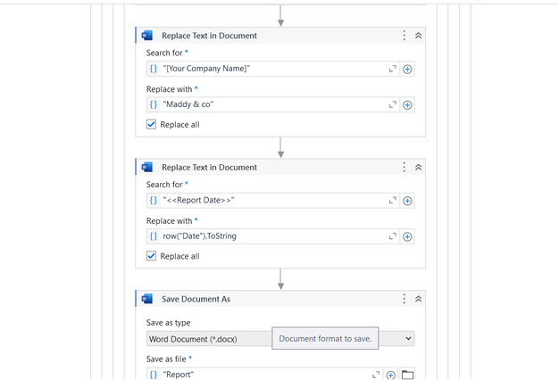
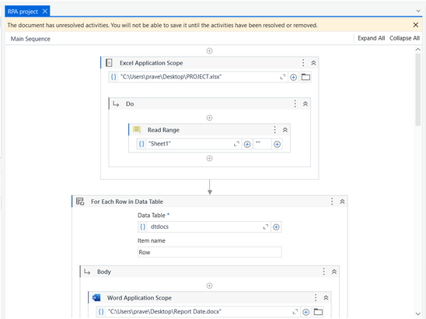
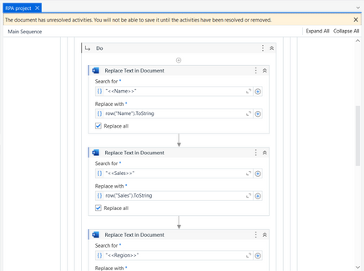
Process Design
Department of Computer Science and Engineering
Rajalakshmi Engineering College ‹#›
Notes:
‹#›

Slide 12
Implementation
Implementation of Module 1
Description
Screen shots
Implementation of Module 2
Description
Screen shots
Department of Computer Science and Engineering
Rajalakshmi Engineering College ‹#›
Notes:
‹#›

Slide 13
Testing
Description
Screen shots
Department of Computer Science and Engineering
Rajalakshmi Engineering College ‹#›
Notes:
‹#›

Slide 14
Conclusions
The Sales Report Automation project successfully streamlines the process of generating, personalizing, and distributing sales reports. By automating tasks such as placeholder replacement, file saving, and email dispatch, the bot eliminates manual effort, reduces human error, and saves time. This enhances operational efficiency and ensures timely and accurate delivery of reports to stakeholders. The project demonstrates how RPA (Robotic Process Automation) can be effectively used to optimize repetitive workflows, enabling businesses to focus on strategic activities while maintaining high-quality deliverables.
Department of Computer Science and Engineering
Rajalakshmi Engineering College ‹#›
Notes:
‹#›

Slide 15
Future Enhancement
Description 1
Description 2
Department of Computer Science and Engineering
Rajalakshmi Engineering College ‹#›
Notes:
‹#›

Slide 16
IEEE Paper
Title
Authors
Department of Computer Science and Engineering
Rajalakshmi Engineering College ‹#›
Notes:
‹#›

Slide 17
References
Journals
Department of Computer Science and Engineering
Rajalakshmi Engineering College ‹#›
Notes:
‹#›

Slide 18
Queries
Notes:
‹#›

Slide 19
Demonstration
Notes:
‹#›

Slide 20
Thank You
Notes:
‹#›

